Slide 1
Chapter 2: The Physical Layer
1 What is the basic goal of the physical layer?
2 How to define the physical layer protocols?
3 What is the theoretical basis for the physical layer?
*4 What are the commonly used transmission media?
*5 What are the common physical layer interface standards?

Slide 2
Keypoints and Difficulties
Keypoints:
Nyquist's Law and Shannon-Hartley theorem
Symbol code types: NRZ, Manchester encoding, Differential Manchester encoding
Difficulties:
Channel transmission rate calculation

Slide 3
1 The Goals
To ensure the correctness of the transmitted signals "0" and "1" and the consistency of transmission and reception;
Bit – transmission mode, speed, duration, and signal distortion;
Interface design: the number of pins, specifications, functions, etc.;
Signal transmission procedures: how to arrange the transmission process and the order of events;

Slide 4
Four Important Characteristics
Mechanical Characteristics
Specifies the size of the connector used in the physical connection, the number and arrangement of pins.
Electrical Characteristics
Specifies the transmission mode, voltage level, coding, impedance matching, transmission rate and distance limit when transmitting the binary bit.

Slide 5
Four Important Characteristics
Functional Characteristics
Define the function of each physical line, indicating the means of a special voltage appears on a line
Line functions are divided into four categories: Data, Control, Timing, Power Supply
Procedural Characteristics
Define the working rules and timing relationships for each physical line
Signal transmission: simplex, half duplex, full duplex

Slide 6
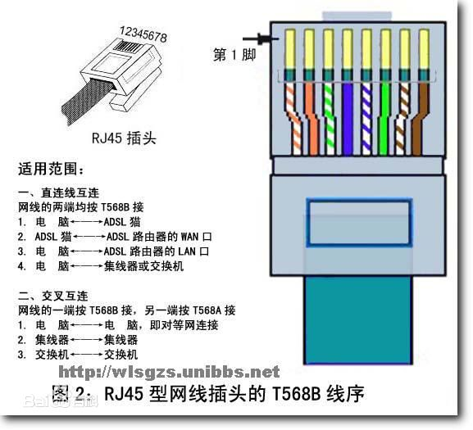
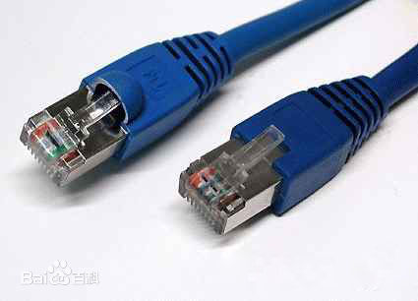
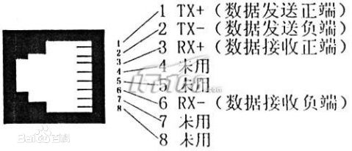


Slide 7

2 Contents of Physical Layer Protocol
Responsible for reliably transmitting bit data from one end of the physical medium to the other

Slide 8
3 Basic theory of data communication
(1) Basic concepts
(2) For a specific physical communication channel, what is the maximum transmission rate? Infinite?
(3) How to transmit Bits in specific physical communication channels? Transmission speed, transmission duration, signal distortion?
(4) In order to save communication equipment and costs, how to transmit the information of multiple computers in one physical channel?

Slide 9
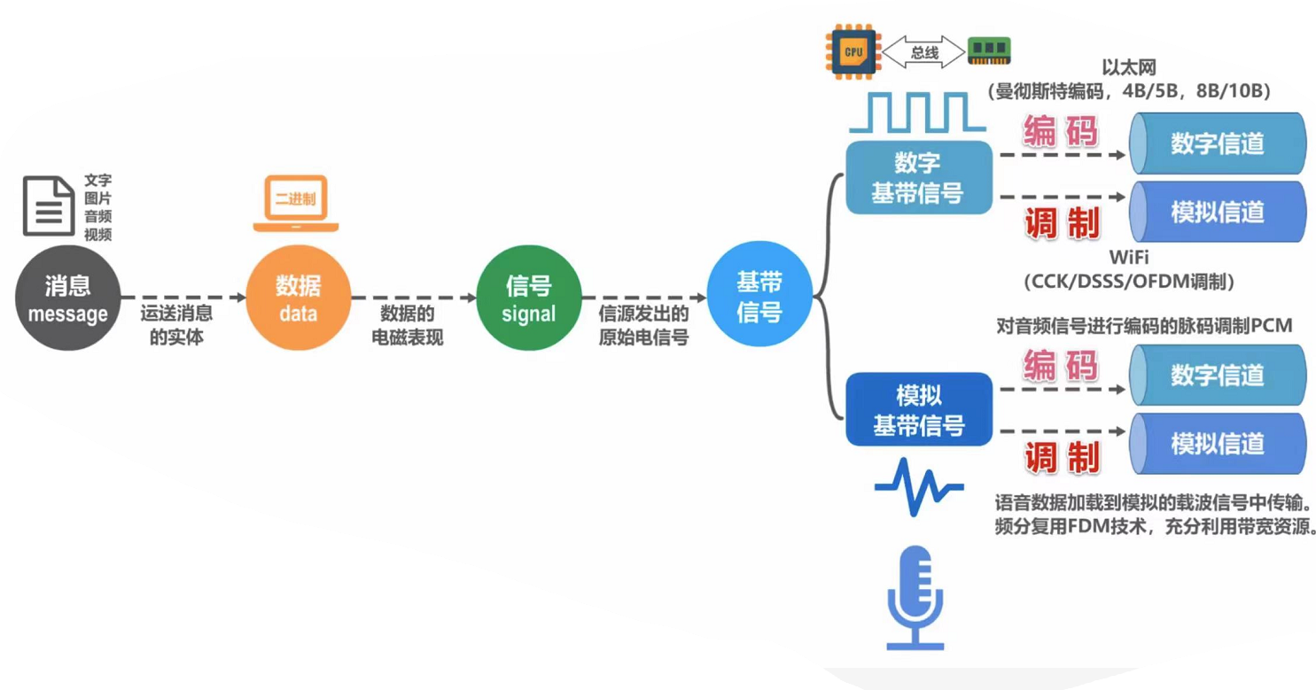
（1）Basic concepts
Data： Physical symbols describing objective facts
Signal： Form of data transmission process
Channel: media that sends information in a certain direction

Slide 10
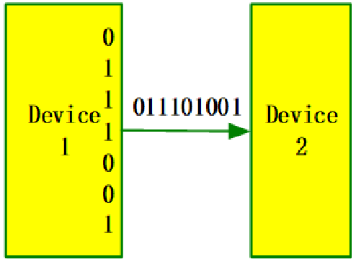
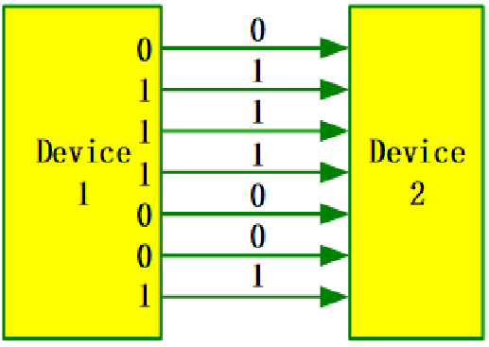
(1) Basic concepts
Serial transmission
Parallel transmission
Suitable for long distance communication
Suitable for short distance communication

Slide 11
(1) Basic concepts

Slide 12
3 Basic theory of data communication
(1) Basic concepts
(2) For a specific physical communication channel, what is the maximum transmission rate? Infinite?
(3) How to transmit Bits in specific physical communication channels? Transmission speed, transmission duration, signal distortion?
(4) In order to save communication equipment and costs, how to transmit the information of multiple computers in one physical channel?

Slide 13
(2) Channel Characteristics
Symbol: A digital pulse, which represents the basic waveform of a discrete value
ASCII code of letter ‘A’: 1000001, can be represented by 7 pulses/symbols
The amount of information carried by a symbol is determined by the number of discrete values taken by the symbol
Two discrete values (“0” or “1”): 1 bit
Four discrete values for a symbol: 2 bits
If N discrete values for a symbol of n (bits), then
n = log₂N

Slide 14
(2) Channel Characteristics
Baud rate (modulation rate or symbol rate)：
The number of times the signal changes every second
1 baud sends one symbol per second
Bit rate：
The number of bits transmitted per second
Relationship between them:
If each symbol has n bits: bit rate (b/s) = baud rate * n
If each symbol has 3 bits, then the bit rate is three times the baud rate
If each symbol has 1 bit, the bit rate and baud rate are the same

Slide 15
(2) Channel Characteristics
Channel capacity (bandwidth in networks)
The maximum number of bits that can be transmitted over a channel per unit time, expressed in bps
Frequency bandwidth (in communication)
Frequency range of the signal allowed by the channel (= maximum frequency - minimum frequency), in Hz
E.g., people can hear sound waves of 20Hz ~ 20kHz, i.e., frequency bandwidth of hearing system is19980Hz

Slide 17
(2) Channel Characteristics
Nyquist's Law :
1) For an ideal low-pass channel with the frequency bandwidth of W (Hz), its maximum symbol transmission rate = 2W Baud
2) For an ideal band-pass channel with the frequency bandwidth of W (Hz), its maximum symbol transmission rate = W Baud
Question
The frequency band of a standard telephone channel is 300 ~ 3400Hz, i.e., the frequency bandwidth is 3100Hz. What is the maximum symbol transmission rate through the ideal low-pass channel?

Slide 18
(2) Channel Characteristics
Actual channels are not ideal – Distortion exists
Higher symbol transmission rate
Farther signal transmission distance
Small and recognizable distortion
Large and unrecognizable distortion
Larger distortion

Slide 19
(2) Channel Characteristics
Nyquist's Law :
1) For an ideal low-pass channel with the frequency bandwidth of W (Hz), its maximum symbol transmission rate = 2W Baud
2) For an ideal band-pass channel with the frequency bandwidth of W (Hz), its maximum symbol transmission rate = W Baud
Question
The frequency band of a standard telephone channel is 300 ~ 3400Hz, i.e., the frequency bandwidth is 3100Hz. What is the maximum symbol transmission rate through the ideal low-pass channel?

Slide 20
(2) Channel Characteristics
Shannon’s Formula: limit information transmission rate C of channel can be expressed as:
W - Frequency bandwidth in Hz
S - Average signal power through the channel
N - Gaussian noise power through the channel
S/N – related to signal-to-noise ratio
Typically in db (decibels):
Actual rate much lower than C due to signal loss
Possible to achieve error-free transmission as long as transmission rate < C
C = Wlog₂(1+S/N)
10 log₁₀S/N

Slide 21
(2) Channel Characteristics
Example:
For the standard telephone channel with frequency bandwidth of 3.1 kHz, if the signal-to-noise ratio S/N = 2500, then can the information transmission rate be 50kb/s?
Solution:
Put W = 3.1kHz, S / N = 2500 into Shannon’s Formula
The limit information transmission rate is 35kb/s, so it is impossible to reach 50kb/s
In order to achieve 50kb/s, you can
improve the signal-to-noise ratio in the channel
or increase the frequency bandwidth

Slide 22
3 Basic theory of data communication
(1) Basic concepts
(2) For a specific physical communication channel, what is the maximum transmission rate? Infinite?
(3) How to transmit Bits in specific physical communication channels? Transmission speed, transmission duration, signal distortion?
(4) In order to save communication equipment and costs, how to transmit the information of multiple computers in one physical channel?

Slide 23
Techniques in analog/digital transmission

Slide 24
Modulation / demodulation system model

Slide 25

Coding / decoding system model
x(t)
Digital signal
g(t)
g(t)
Encoder
Decoder
Digital or
Analog data
Digital channel
Digital or
Analog data
coding
decoding
sender
receiver

Slide 26
Modulation (digital data to analog signals)
Digital and carrier signals
Amplitude Modulation (AM)

Slide 27

Modulation (digital data to analog signals)
Frequency Modulation (FM)
Phase Modulation (PM)

Slide 28
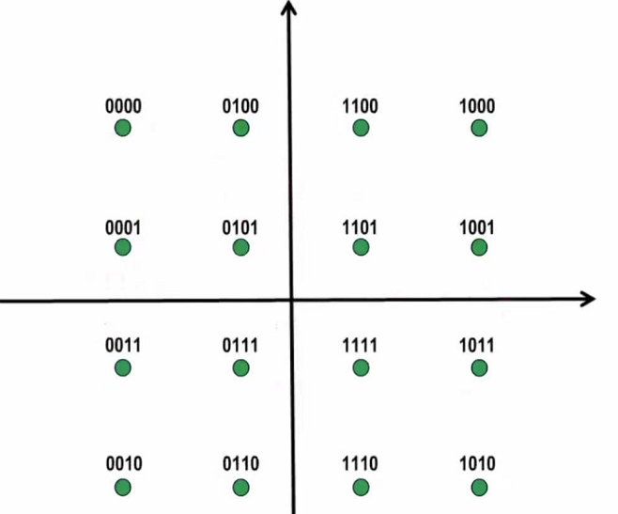
Modulation (digital data to analog signals)
Quadrature Amplitude Modulation (QAM)
PM and AM techniques
If there are x changes in phase and y changes in amplitude, then there are x * y combined changes
4-QAM constellation table
16-QAM constellation table

Slide 29
Pulse Code Modulation (PCM) (analog data to digital signals)
Sampling Theorem
As long as the sampling frequency is not less than twice the maximum frequency of the signal, the original signal can be recovered from the sampling pulse without distortion
PCM system model

Slide 30
Pulse Code Modulation (PCM) (analog data to digital signals)
Voice signal digitization
Voice frequency bandwidth f <4kHz
Sampling clock frequency: 8kHz (> 2 times the maximum voice frequency)
Sample quantization series: 256 (8bit / per sample)
Data rate: 8000 times / s * 8bit = 64kb / s
The rate of each PCM signal = 64kb / s

Slide 31
Pulse Code Modulation (PCM) (analog data to digital signals)
PCM coding process example

Slide 32
Digital signal coding (digital data to digital signals)
Non-Return-to-Zero (NRZ)
Manchester encoding
Differential Manchester encoding
Block encoding (4B / 5B, 8B / 10B)

Slide 33
Digital signal coding (digital data to digital signals)
Non-Return-To-Zero Level (NRZ-L) Coding

Slide 34
Digital signal coding (digital data to digital signals)
Disadvantages of NRZ-L
Difficult to tell the end of one and the beginning of another
The sender and the receiver must have clock synchronization
If the signal "0" or "1" appears continuously, the signal DC component will accumulate
Prone to propagation errors

Slide 35
Bit synchronization
The purpose is to synchronize each bit of information received by the receiver with the sender
External synchronization
Self-synchronization

Slide 36
Digital signal coding (digital data to digital signals)
Manchester Coding
Each symbol is divided into two equal intervals
"1": the previous interval is high and the next low
"0": the previous interval is low and the next high
Feature: A level hop in the middle time of each symbol

Slide 37
Digital signal coding (digital data to digital signals)
Advantages
Overcoming the disadvantages of the NRZ Coding
Each jump in the middle of a symbol can be used as data, and also as a clock for self-synchronization
Disadvantages
Doubling the frequency bandwidth requirement of the transmission channel
High-frequency noise also increases – susceptible to noise interference
Ambiguous

Slide 38
Digital signal coding (digital data to digital signals)
Differential Manchester Coding
"1": the level of the first half of the symbol is the same as the level of the second half of the previous symbol
"0": the level of the first half of the symbol is opposite to the level of the second half of the previous symbol
Regardless of whether the previous bit is 1 or 0
Waveform 1
Assuming the previous bit rises from low to high
Waveform 2
Assuming the previous bit drops from high to low

Slide 39
Digital signal coding (digital data to digital signals)
Advantages
Regardless of whether the symbol is "1" or "0", there must be a level hop in the middle of each symbol => better anti–interference performance
Separation between bit clock and data => easy data extraction
Transition uniquely determined by the second half of the previous symbol => ambiguity eliminated
Disadvantages
Doubling the frequency bandwidth requirement of the transmission channel
High-frequency noise also increases – susceptible to noise interference

Slide 40
Digital signal coding (digital data to digital signals)
Exercise:
Draw the waveform of "001101" with
NRZ-L
Manchester Coding
Differential Manchester Coding

Slide 41
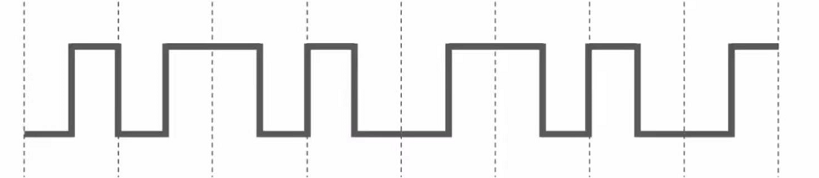
Exercise-3
If the following figure shows the signal waveform received by the 10Base-T network interface card, the bit string received by the network interface card is
A. 00110110 B. 10101101 C. 01010010 D. 11000101
Notes:
10BASE-T传统以太网采用的曼彻斯特编码，该编码把每个码元分成前后两部分，前一个部分为高电平而后一个部分为低电平表示码元 1，反之为 0。

Slide 42
Digital signal coding (digital data to digital signals)
Block Coding
Advantages
Can improve the coding efficiency, reduce the modulation rate, and reduce the transmission line requirements
Some redundant bits can be added for error detection or synchronization
Applications
4B / 5B (FDDI, 100M Fast Ethernet)
8B / 10B (Gigabit Ethernet)

Slide 43
Digital signal coding (digital data to digital signals)
Steps (mB / nB, m < n)：
Grouping
Substitution
The extra bit sequence can be used for
error detection
synchronization
or other controls
or not used
Line coding

Slide 44
3 Basic theory of data communication
(1) Basic concepts
(2) For a specific physical communication channel, what is the maximum transmission rate? Infinite?
(3) How to transmit Bits in specific physical communication channels? Transmission speed, transmission duration, signal distortion?
(4) In order to save communication equipment and costs, how to transmit the information of multiple computers in one physical channel?

Slide 45
Multiplexing (Multi-pass)
To send multiple sources of information in one physical channel at the same time
Commonly used techniques
Frequency division multiplexing (FDM)
Time division multiplexing (TDM)
Wavelength division multiplexing (WDM)
Code division multiplexing (CDM)

Slide 46
*Multiplexing : FDMA
FDMA: frequency division multiple access
channel spectrum divided into frequency bands
each station assigned fixed frequency band
unused transmission time in frequency bands go idle
example: 6-station LAN, 1,3,4 have pkt, frequency bands 2,5,6 idle
time
frequency bands
FDM cable

Slide 47
*Multiplexing : Orthogonal frequency division multiplexing (OFDM) technology
Basic principle:
Dividing the channel into a number of orthogonal sub-channels;
The high-speed serial data is decomposed into multiple parallel low-speed data, the use of multi-carrier FDM method to transfer, that is, the data allocated to a large number of sub-channels for transmission.
Suitable for the high-speed data transmission through wireless channel under the presence of multipath propagation and Doppler shift.

Slide 48
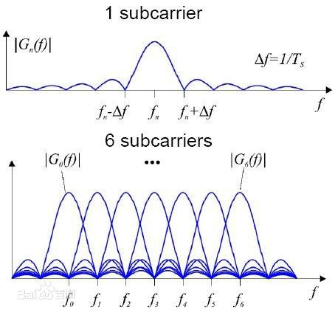
*Multiplexing : Orthogonal frequency division multiplexing (OFDM) technology

Slide 49
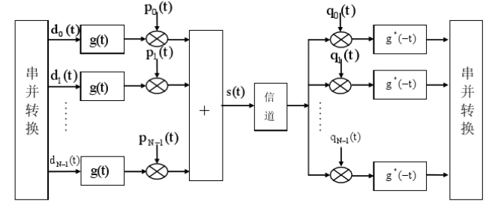
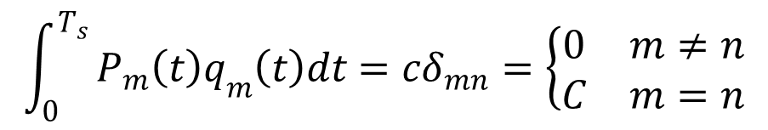
*Multiplexing : Orthogonal frequency division multiplexing (OFDM) technology

Slide 50
*Multiplexing : Orthogonal frequency division multiplexing (OFDM) technology
FFT based OFDM Transmit System
FFT based OFDM Receiving System

Slide 51
*Multiplexing : Orthogonal frequency division multiplexing (OFDM) technology
Advantages:
Reduce the influence of inter-symbol interference;
Reduce the effect of frequency selective fading;
Improve the band utilization, to avoid the crosstalk between sub-channels;
Nearly eliminate inter-symbol interference;
Anti-interference coding technology can be used to effectively recover the error;
The parallel data can be modulated and demodulated by discrete Fourier transform DFT, which reduces the complexity of system implementation.

Slide 52
*Multiplexing : Orthogonal frequency division multiplexing (OFDM) technology
Applications of OFDM technology:
ADSL
Digital Audio Broadcasting (DAB)
HDTV
Wireless LAN (WLAN)
Broadband radio access network
3G mobile communication network and other fields.

Slide 53
*Multiplexing : Wavelength division multiplexing (WDM)
Transmission of multiple optical carriers with different wavelengths in a fiber at the same time
WDM is actually a variant of FDM for fiber channel multiplexing.

Slide 54
*Multiplexing : TDMA
TDMA: time division multiple access
access to channel in "rounds"
each station gets fixed length slot (length = pkt trans time) in each round
unused slots go idle
example: 6-station LAN, 1,3,4 have pkt, slots 2,5,6 idle
6-slot
frame
6-slot
frame
1
3
4
1
3
4
Notes:
TDM (Time Division Multiplexing): channel divided into N time slots, one per user; inefficient with low duty cycle users and at light load.
FDM (Frequency Division Multiplexing): frequency subdivided.

Slide 55
*Multiplexing : TDMA
Classification of TDM
Synchronous TDM:
Time slice fixed allocation, suitable for fixed rate transmission
The time slice of the physical channel is fixedly allocated to several users for data transmission, and each user uses the channel for data transmission when its corresponding time slice arrives.
Advantages: simple implementation.
Disadvantages: there is a waste of bandwidth.
Synchronous TDM technology is suitable for fixed rate data communication system.

Slide 56
*Multiplexing : TDMA
Asynchronous TDM:
The time slot of the physical channel is fixedly allocated for several, and the user does not occupy a certain time slice.
When a user needs to carry out data transmission, to assign a time slice;
If the user does not have the data transmission requirements, the system does not allocate the time slice to the user, the corresponding time slice can be allocated to other users.
Advantages: On-demand distribution of channel time slices, high utilization rate.
Disadvantages: complex implementation.
Asynchronous TDM technology is suitable for variable rate communication systems.

Slide 57
*Multiplexing : TDMA

Slide 58
*Multiplexing : Code Division Multiple Access (CDMA)
unique “code” assigned to each user; i.e., code set partitioning
all users share same frequency, but each user has own “chipping” sequence (i.e., code) to encode data
allows multiple users to “coexist” and transmit simultaneously with minimal interference (if codes are “orthogonal”)
encoded signal = (original data) X (chipping sequence)
decoding: inner-product of encoded signal and chipping sequence

Slide 59
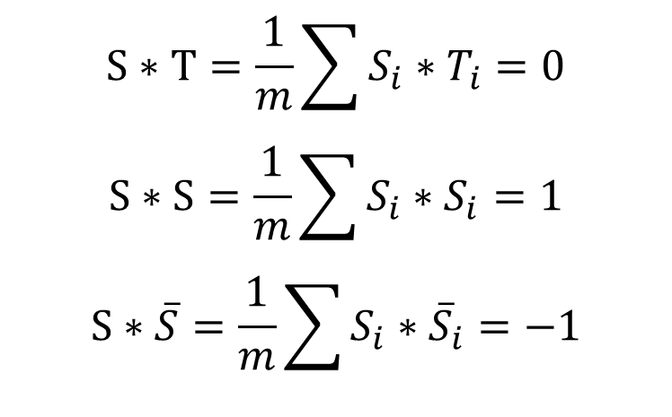
$$S∗T=\frac{1}{m}\sum{S_{i}∗T_{i}}=0$$
$$S∗S=\frac{1}{m}\sum{S_{i}∗S_{i}}=1$$
$$S∗\overline{S}=\frac{1}{m}\sum{S_{i}∗{\overline{S}}_{i}}=−1$$

Slide 60
*Multiplexing : CDMA encode/decode
channel output Z_{i,m}
Z_{i,m}= d_{i}.c_{m}
data
bits
d₀ = 1
1
1
1
1
1
d₁ = -1
1
1
1
-
-
-
-
1
-
-
-
1
-
1
1
1
1
1
sender
1
1
slot 1
channel
output
slot 0
channel
output
1
1
1
1
1
code
1
1
-
-
-
1
-
1
1
1
-
-
-
1
-
1
1
1
slot 1
slot 0
M
D_{i} = Σ Z_{i,m}.c_{m}
m=1
M
received
input
1
1
1
1
1
1
1
1
d₀ = 1
-
-
-
-
1
-
-
-
1
-
1
1
1
1
1
1
d₁ = -1
1
slot 1
channel
output
slot 0
channel
output
1
1
1
1
1
code
1
1
-
-
-
1
-
1
1
1
-
-
-
1
-
1
1
1
receiver
slot 1
slot 0

Slide 61
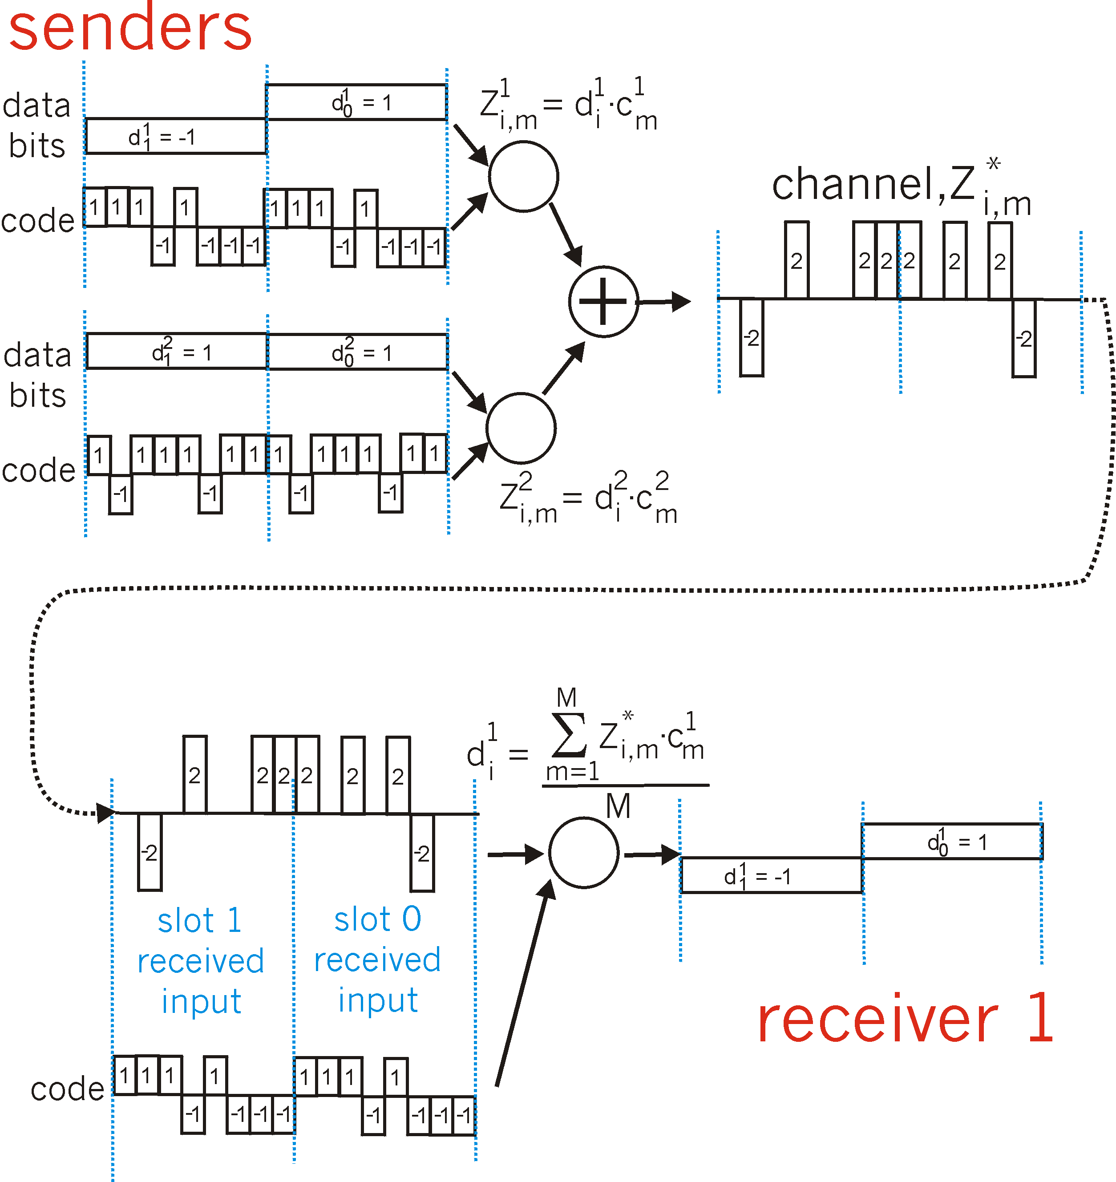
*Multiplexing : CDMA: two-sender interference
channel sums together transmissions by sender 1 and 2
Sender 1
Sender 2
using same code as sender 1, receiver recovers sender 1’s original data from summed channel data!

Slide 62
*Comparison of commonly used media
Transmission medium
Transfer method
Rate/
Band
Transmission distance
Performance
Price
Application
Twisted pair
Broadband
Baseband
≤1Gb/s
Anolog: 10km
digtal: 500m
Better
Low
Analog / digital signal transmission
50Ω
Coaxial cable
Baseband
10Mb/s
<3km
Better
Lower
Baseband digital signal
75Ω
Coaxial cable
Broadband
≤450MHz
100km
Better
Lower
Analog TV, data and audio
Optical fiber
Baseband
40Gb/s
20km以上
Very good
Higher
Long - distance high - speed data transmission
Microwave
Broadband
4-6GHz
Several hundred km
Good
Medium
Remote communication
Satellite
Broadband
1-10GHz
18000 km
Very good
High
Remote communication

Slide 63
*Commonly used physical layer interface standards
EIA-232-E interface standard
RS-449 interface standard
RS-485 interface standard
CAN interface standard
PROFIBUS interface standard
…….

Slide 64
Recap of the Physical Layer
The function of the physical layer and the issues to be considered
Four important characteristics of the physical layer
The contents of the physical layer protocol
Some Basic Concepts in Data Communication
Nyquist's Law and Shannon's Formula
Signal Coding Technology and Multiplexing Technology
Commonly used transmission medias
Commonly used physical layer interface standards

Slide 65
Exercise-1
In the physical layer interface characteristics, the time sequence used to describe the completion of each function is
A. Mechanical Characteristics
B. Electrical Characteristics
C. Functional Characteristics
D. Procedural Characteristics
2. Among the following options, that do not belong to the definition scope of physical layer interface specification is
A. interface shape B. pin function
C. physical address D. signal level

Slide 66
Exercise-2
Under the condition of no noise, if the frequency bandwidth of a communication link is 3kHz and QAM modulation technology with four phases and four amplitudes in each phase is adopted, the maximum data transmission rate of the communication link is
A. 12kbps B. 24kbps C. 48kbps D. 96kbps
2. If the data transmission rate of a communication link is 2400bps and 4-phase modulation is adopted , the baud rate of the link is
A. 600 baud B. 1200 baud
C. 4800 baud D . 9600 baud

Slide 67
Exercise-2
3. If the frequency bandwidth connecting R2 and R3 link is 8kHz and the signal-to-noise ratio is 30dB, and the actual data transmission rate of the link is about 50% of the maximum data transmission rate, the actual data transmission rate of the link is about
A. 8kbps B. 20kbps C. 40kbps D. 80kbps
2. Among the following factors, which will not affect the channel data transmission rate is
A. signal to noise ratio B. frequency bandwidth
C. symbol speed D. signal propagation speed

Slide 68
Exercise-3
If the following figure shows the signal waveform received by the 10Base-T network interface card, the bit string received by the network interface card is
A. 00110110 B. 10101101 C. 01010010 D. 11000101
Notes:
10BASE-T传统以太网采用的曼彻斯特编码，该编码把每个码元分成前后两部分，前一个部分为高电平而后一个部分为低电平表示码元 1，反之为 0。

